Slide 1
NFL Injury Predictions
Analytic approach for predicting injuries
**RIP Chubb**

Slide 2
Injury Analysis Overview
Effects that playing on synthetic vs natural turf
Factors such as weather, play type and player position .
250 complete player in-game histories from two subsequent NFL regular seasons.

Slide 3
Questions to ask ourselves:
-- what is likely the risk of a player’s injury based on turf type?
--Is the Predictions of Injuries Accurate?
--Does the importance of grass type impact injuries?

Slide 4
The Solution….. Data Hazard Model
Kaplan-Meier Estimate (Curve)
Confusion Matrix (Logistic Regression)
Random Forest Classifier

Slide 5
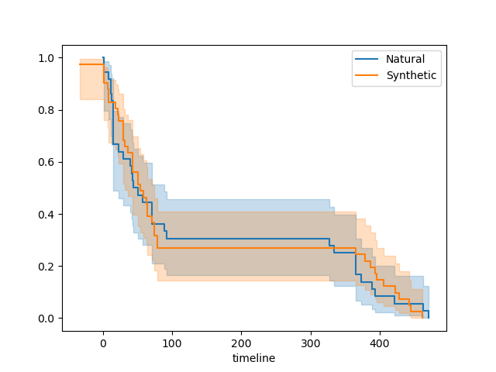
Kaplan Meier Curve
Question: What is likely the risk of a player’s injury based on turf type?
Answer: a small margin between these two curves showing a steep indicated high risk of injury within 100-day period
Notes:
Model to predict the injuries uses to analyze injury occurred over period of number of days played.
Compared two curves for both natural and synthetic grass types
Results shown that for both curves showing an increase likelihood of injuries occurring shown in the steep hill.
Based on the pattern of this curve shows synthetic curve shows a small margin of .05 which indicated more injury risk for the synthetic than natural grass,

Slide 6
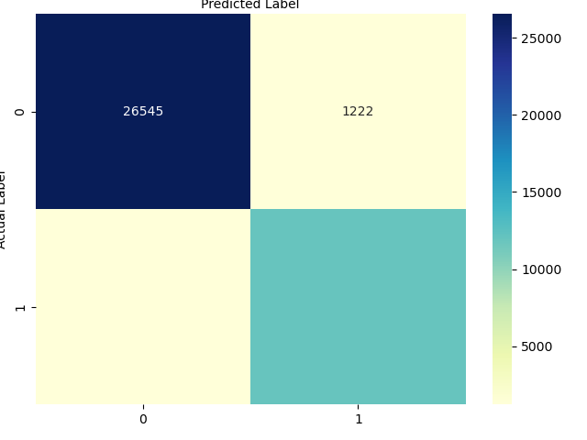
Logistic Regression…also known as confusion matrix
Question: is the predictions of the injuries accurate….?
Answer: No…. shown with 26545 as false negative and 1222 False Positive which means that the prediction of this data is incorrect and inaccurate
Notes:
Regression uses an binary values such as yes, no or true, false to predict the outcome
The confusion matrix is a N x N matrix, where N is the number of classes or outputs.
True Positive (TP) : predicted(1), actual(1)
False Positive (FP) : predicted(1), actual(0)
True Negative (TN) : predicted(0), actual(0)
False Negative (FN) : predicted(0), actual(1)
The data shown with 26545 as false negative and 1222 False Positive which means that the prediction of this data is incorrect and inaccurate

Slide 7
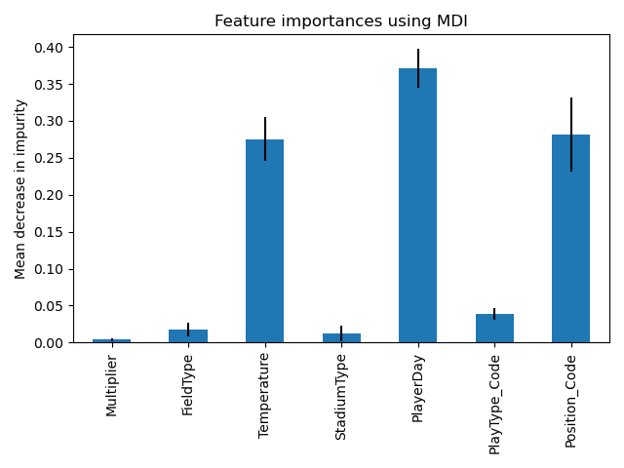
Random Forest Classifier
Question: Does the importance of the grass type affect the injury?
Answer: No….shows that grass types does not impact players injuries
Notes:
is used to evaluate the importance of each feature (or factors that contribute to injuries based on previous predictive model)
Results show that three features temperature, Player Day and Position are shown to have three significant importance which factors the injury.
Interesting part shown as Field Type showing no significant importance impacting the injury prediction.

